Slide 1

Model Documentation and Programming
TEAM 24 GRAB FOOD DELIVERY SIMULATION

Slide 2
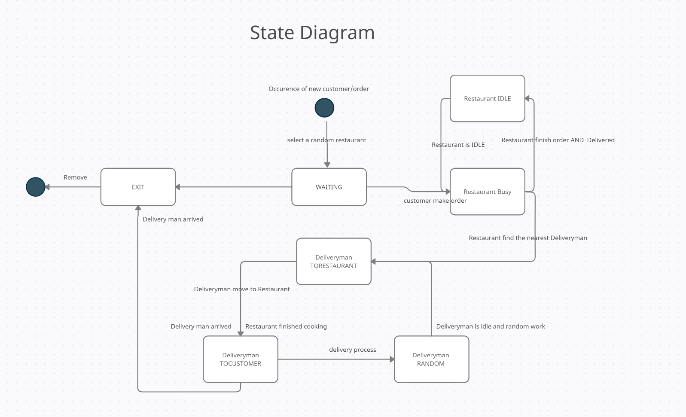
Recap our State diagram first

Slide 3
Overall Procedure
1. Generate random move deliveryman
2. Add building and assign some buildings as restaurants
3. Ensure deliveryman cannot move across buildings
4. Generate customers and assign one random restaurant to each of them
5. What happened when Order arrived [IMPORTANT]
6. What happened when Order finished [IMPORTANT]
7. Statistics
8. Slider bar & Graph.
9. Special:
Region can Change to simulate city segmentation
3 types of deliveryman
Like class examples
I will explain very briefly
IMPORTANT!!!
Detail explain provided
For 5-9: Step by step scripts is available inside Explain folder

Slide 4
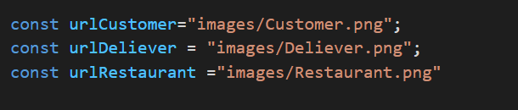
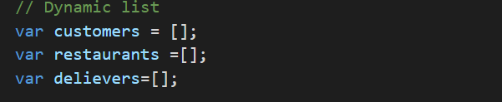
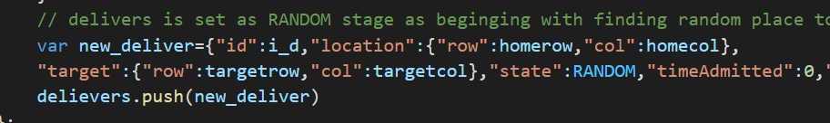
1. Generate random move deliveryman
Initialization
Line 13-15
Line 35-37
Push the new element in dynamic list inside addDynamicAgents() function
Line 463-464, 475

Slide 5
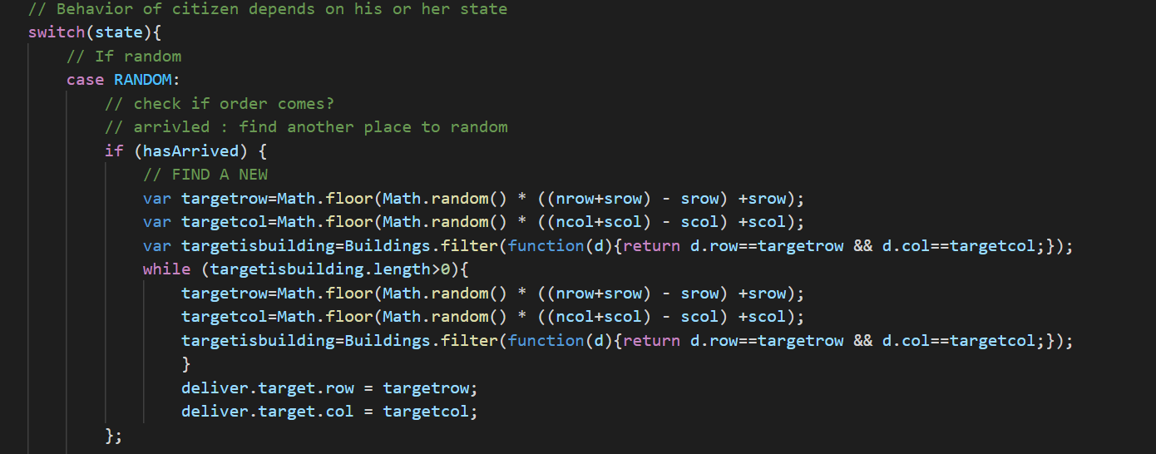
1. Generate random move deliveryman
Continually random walk in updateDeliver() function after finish the RANDOM state : Assign new random target
Line 544-561

Slide 6
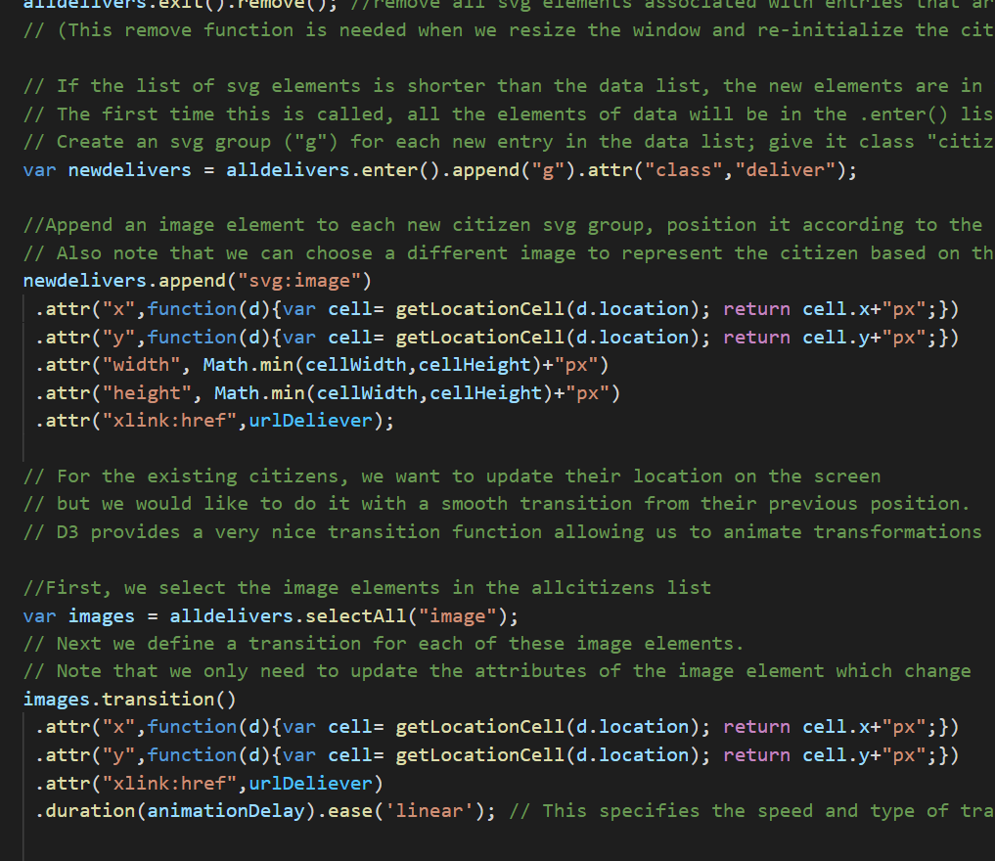
1. Generate random move deliveryman
Use D3 to show the animation and smooth the move transition
Line 320-350

Slide 7
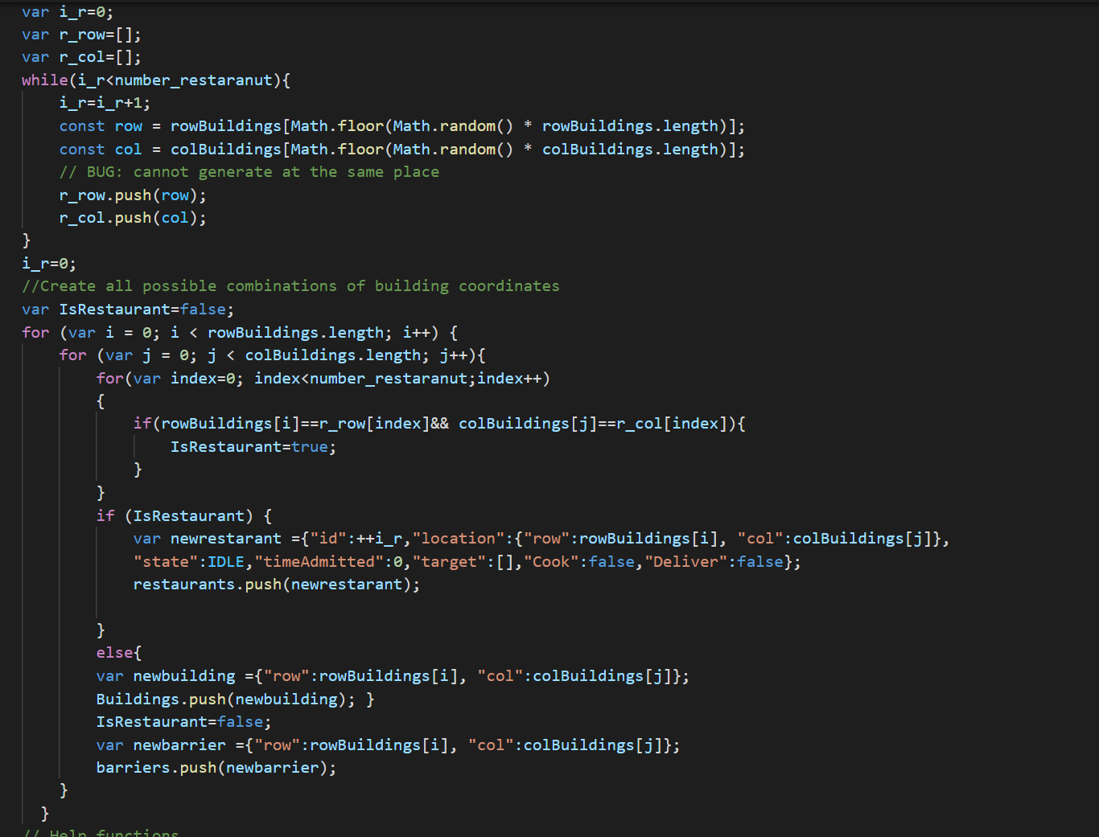
2. Add building and assign some buildings as restaurants
Get a row and column dynamic list for restaurant
Generate random row OR col value and store in the two lists
When go through all building check if current building is a restaurant
Push it to the restaurants list
Others are buildings
Line 79-112

Slide 8
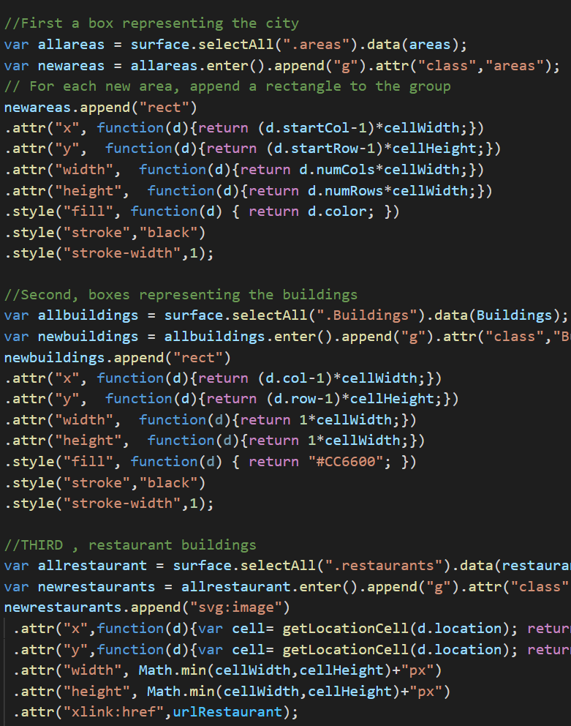
2. Add building and assign some buildings as restaurants
In D3 function:
Update for building as rect svg
Update for restaurant as image svg
Line 355-388

Slide 9
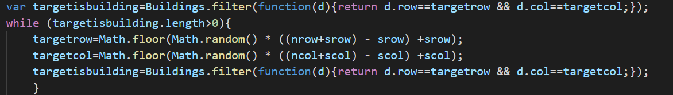
3. Ensure deliveryman cannot move across buildings
1. Filter the building with same locations as deliver.taget
2. We need to regenerate for the overlapping one and get new non-building target
Line 454-459

Slide 10
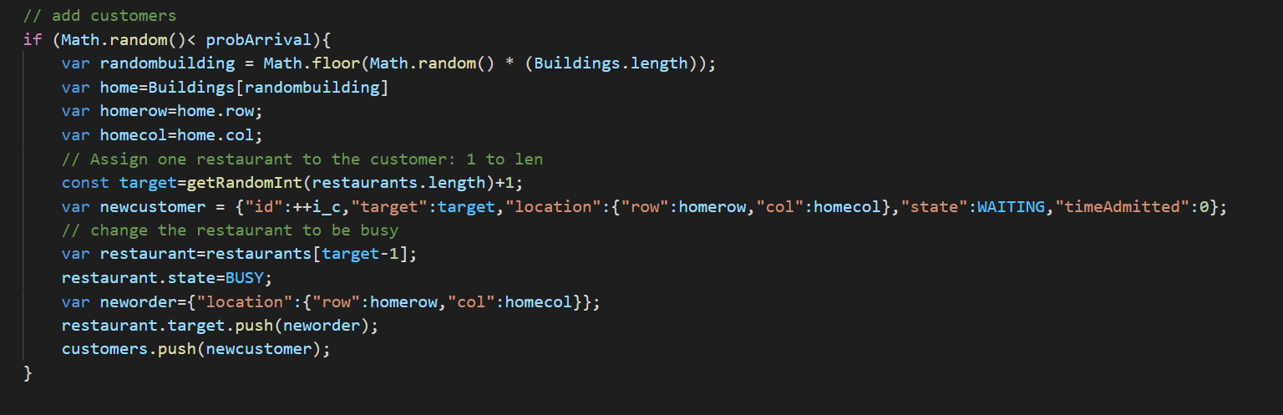
4. Generate customers and assign one random restaurant to each of them
This is the stage that customers come to model!!!
In addDynamicAgents() generate with probArrival
Line 480-494
Important! When pair customers and delivery man
Random assign the customer to one restaurant and update restaurant attibutes

Slide 11
5. What happened when Order arrived
We have 3 agents and all of them need to consider when order just placed!
Customer: It will be assigned to one restaurant and then become WAITING stage what we already seen.
Restaurant: The order will be queuing and wait for processing.
Restaurant will also start looking for delivery guy if they start cooking the order
Restaurant is the middleman and need capture information and smooth the flow.
Delivery guy: They will be chosen with min-distance policy and stage become TORESTAURANT

Slide 12
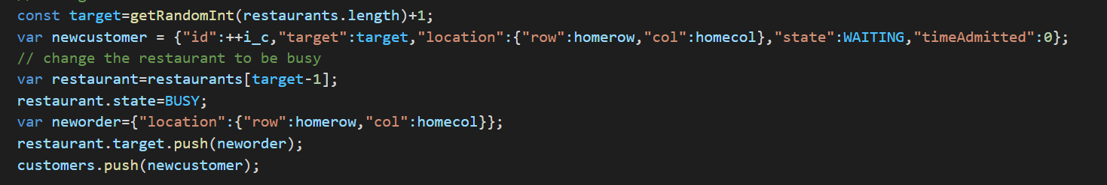
Customer???
Customer itself:
Stage
Assign to a random restaurant
Stage is now WAITING
Line 486-494

Slide 13
Customer???
Customer -> Restaurant
Stage updating
Capture Customer information: to pass to delivery guy later
Stage is now BUSY
Line 486-494

Slide 14
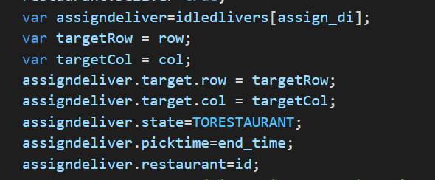
Restaurant???
As the intermediate guy between customers and delivery guy. It need to capture both information from two parties. So that the delivery guy can set the target as the correct customer after restaurant finished cooked the order.
From Customers
Line 492-493
Information Flow
To Delivery guy
Line 739-746

Slide 15

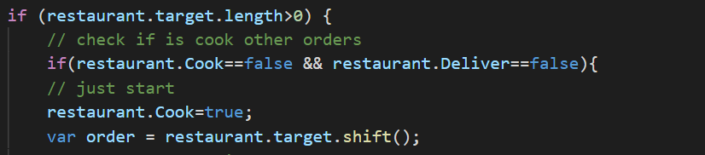
Restaurant???
There might be multiple orders come to the same restaurant hence, it should have a priority queue for the restaurant so that can cook the order as the order they comes.
It should cook when the previous order finished
Push in
Line 490-493
Finish cook and be delivered
Shift out
Line 709-714

Slide 16
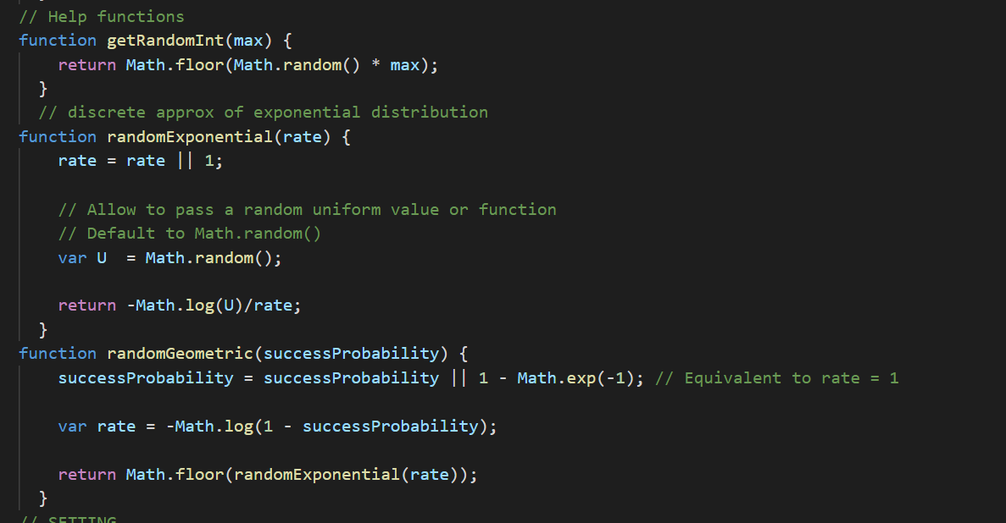
Restaurant???
Wait!!! No restaurant can fulfill the order immediately!
Need to have some cooking time + Discrete time step simulation
Exponential VRS -> Geometric VRS
Use Inverse transformation method to generate geometric VRS.
Line 129-148

Slide 17
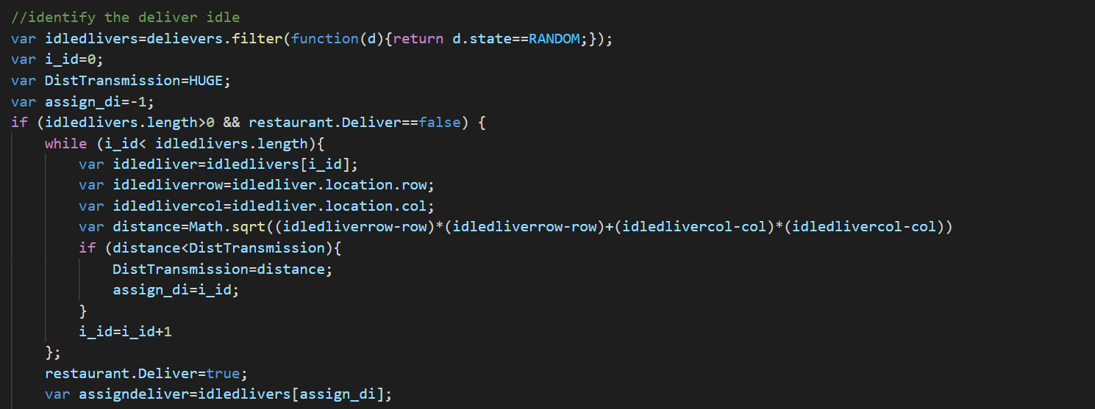
Delivery Guy???
How to choose? Min-Distance + IDLE RANDOM Deliver guy
Min-Distance
Line 722-739

Slide 18
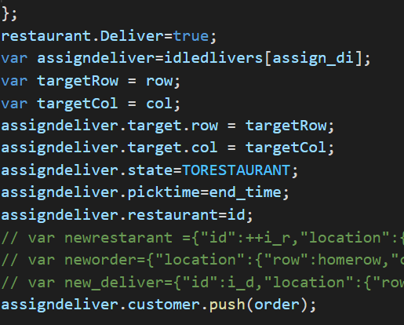
Delivery Guy???
What attributes need to change?
1. Update restaurant no need find anymore deliveryman
2. delivery guy target location
3. delivery guy is ready to go to next State
FIND THE CUSTOMER
Line 738-751
Important!!!

Slide 19
Information Flow
Customer ID
Customer location
Customers
Queue
Customer ID
Customer location
Random assign a restaurant
Restaurants
Find a nearest delivery man
Stop find
Deliveryman

Slide 20
5. What happened when Order arrived
TO SUM UP:
1. We need to make sure the delivery and customer can be correctly matching
2. Restaurants have a priority queue for customer
3. Restaurants also have a priority rule for delivery
Hence : No information and conflicts will happen!
Ready to go to Next step: Order finished!

Slide 21
6. What happened when Order finished
Also consider for all 3 agents
Customers: When order finished, they EXIT the platform
Delivery guy: Back to RANDOM idle stage
Restaurant: NOTHING: They already setup now! :D
As two parties are corrected matched already.

Slide 22
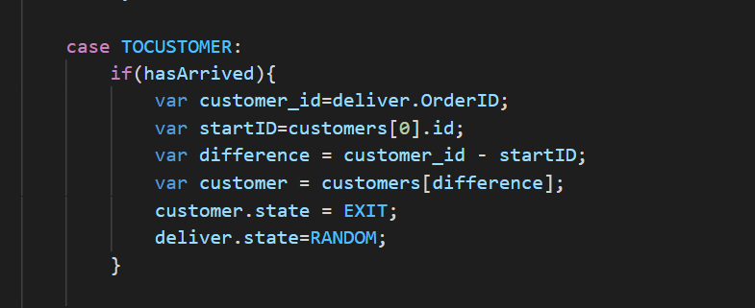
Customers???
When the model know it’s time to change customer stage?
From delivery guy!!! If they arrived.
Line 590-598

Slide 23
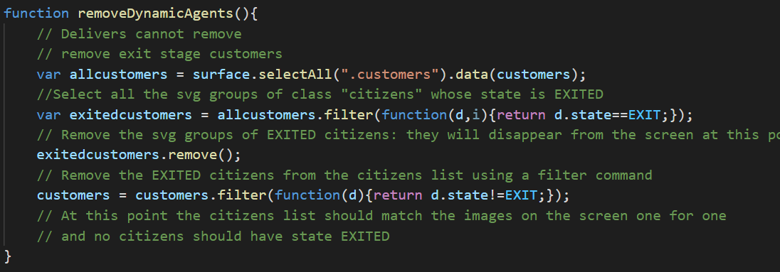
Customers???
Remove the EXIT stage customers
Line 785-797

Slide 24
Delivery Guy???
Pass the information to customers
Change the attributes for itself
Back to RANDOM idle stage
Line 590-598

Slide 25
7. Statistics
Two types of statistics:
1. Our model allow multiple customers be placed inside same block
However, the overlapping make human hard to know the density. Use statistics number to indicate the density @ this block
2. Some useful statistics data to put into output analysis
Servicing Rate
Avg service time

Slide 26
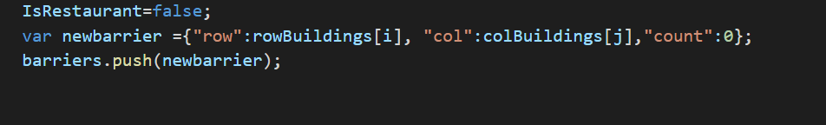
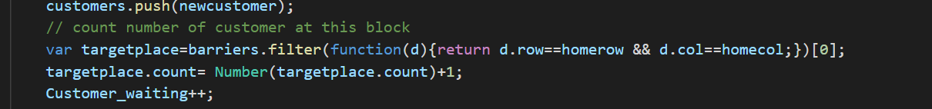
Indicated the customer density
1. Add new attribute : count to the barrier dynamic list
2. This count is increase when customer place order and is removed when customer EXIT
Line 241-243
Line 494-498
Line 681-684

Slide 27
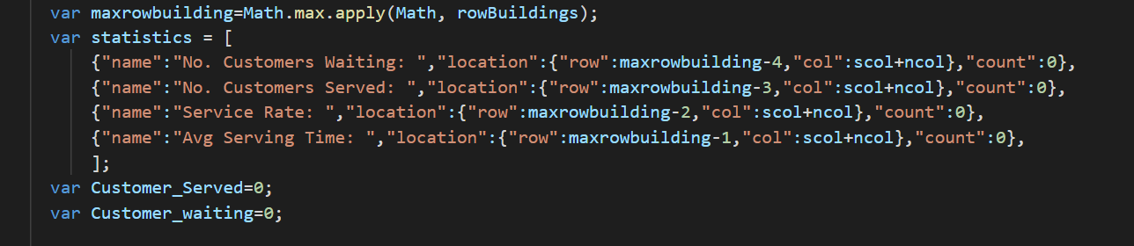
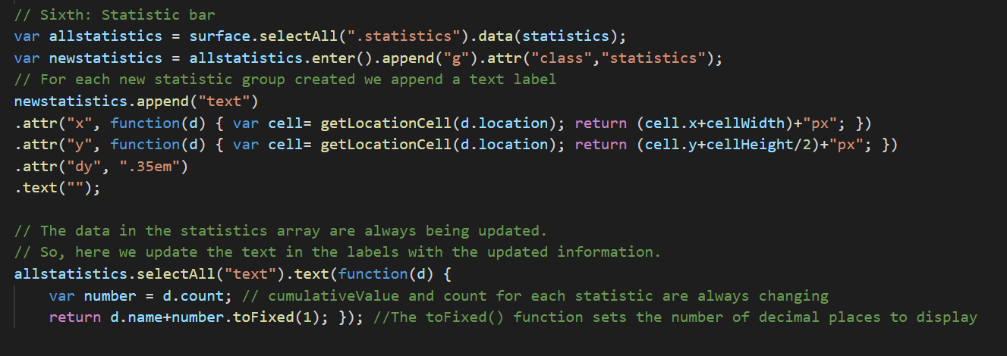
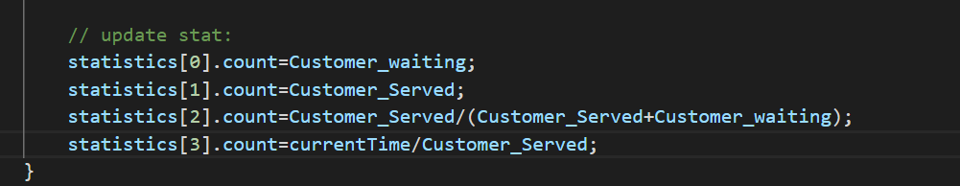
Add statistics for output analysis
Initialization:
Line 117-125
Update
Customer place order : Waiting++
Customer EXIT: Waiting– Serverd++
Show
Line 814-817
Line 418-432

Slide 28
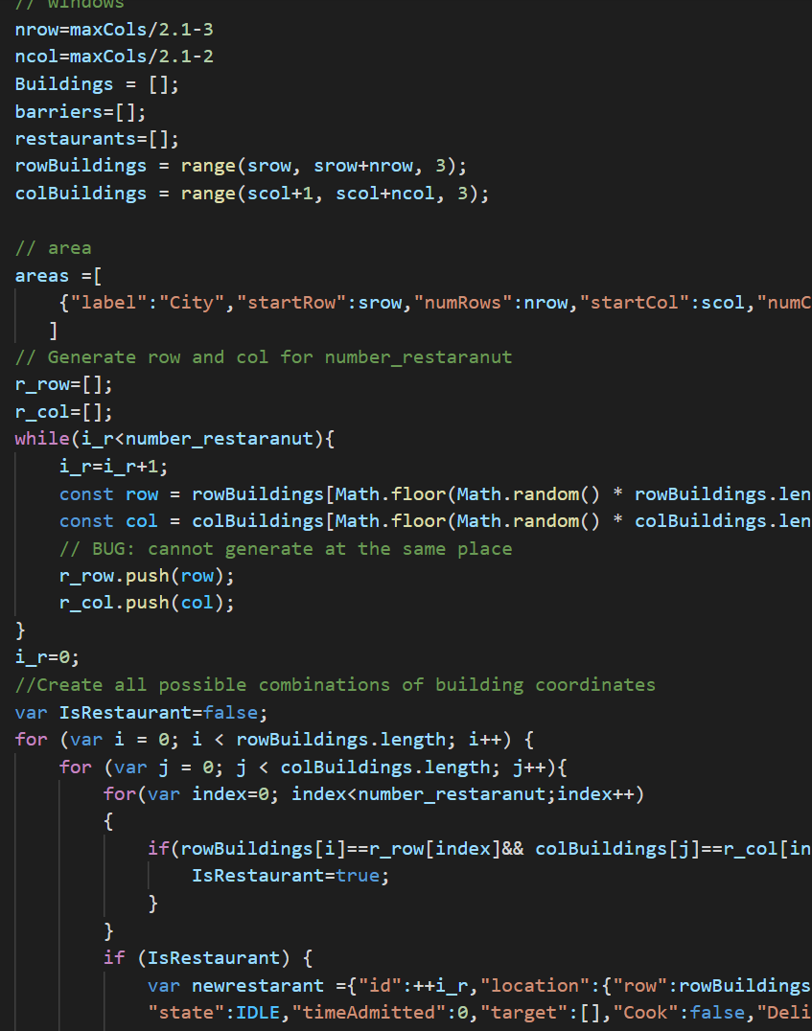
8. Slider Bar & Plot
Follow the same procedure as did in class
Difference:
We need to reinitialize the blocks stuff inside the redRawWindow() function after read in the slider bar value. So that we can use to change the size of the city size, and which is equivalent to segment the fixed size city into different regions.
Line 198-235

Slide 29
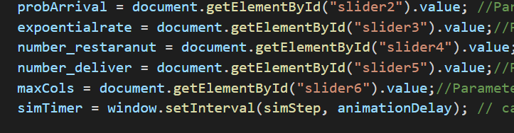
8. Slider Bar & Plot
Slider bar read the user's input
Line 173-178

Slide 30
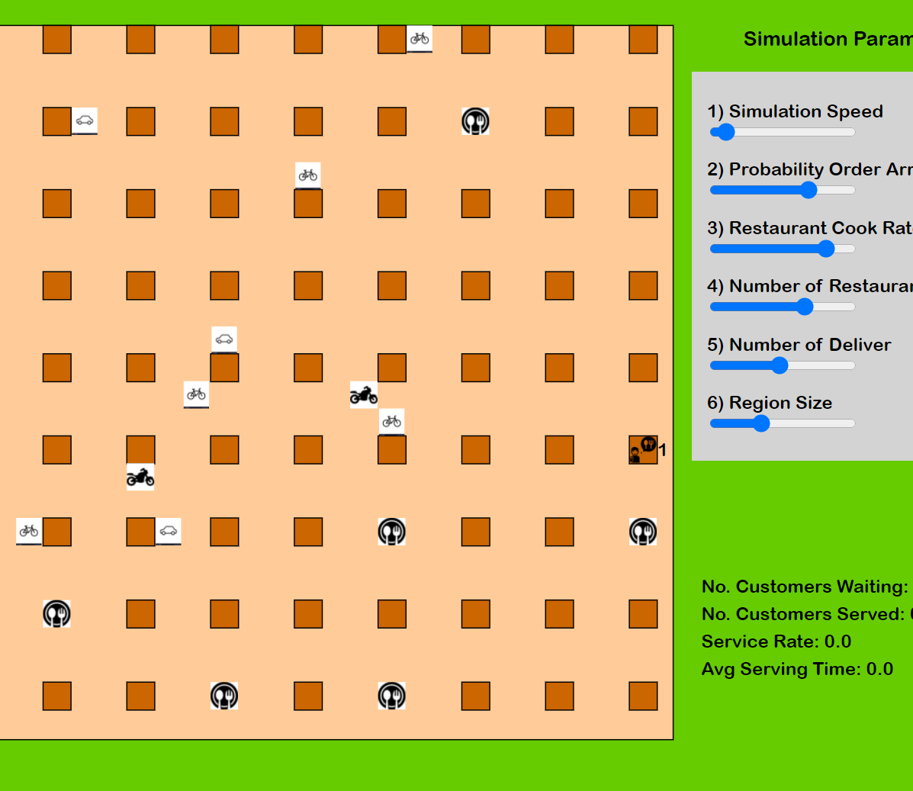
9. Specialty
Our initial project idea to segmented a city into segmented is done by scale the city size and varying other setting.
There are 3 types of transportation, a delivery man can be assigned. Speed difference is implemented via probability idle step movement
With some predefined probability, Transportation A with p<p1 will idle at this time step and not move.

Slide 31
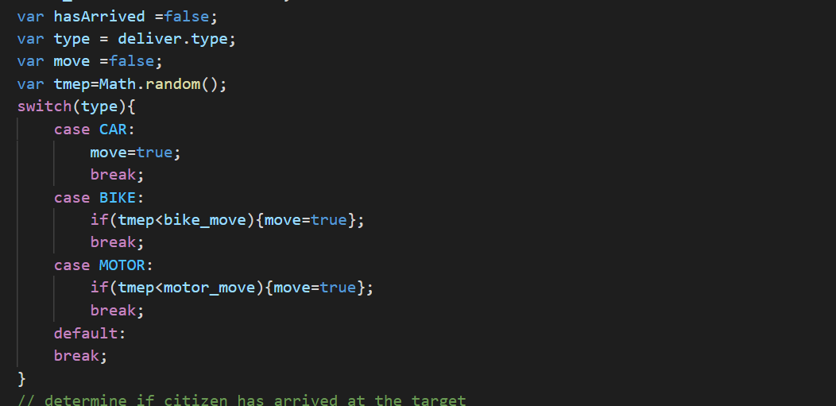
3 types of delivery man
Show
Line 347-350
Move with probability and idle till next timestep
Line 520-535

Slide 32

Thank You!

